Slide 1
Spending Reviews SR process and the methodology
Theo Thomas, Lead Economist
Sanja Madzarevic-Sujster, Senior Economist

Slide 2
Fiscal context – need for structural savings
Croatia is facing persistent structural deficits
Need to reduce deficit by around 4% of GDP
Many countries have managed deficit change through structural reform
2010-14

Slide 3
Spending Reviews (SR) – designed to evaluate policy and identify savings (sustainably)
SR – instrument for policy evaluation
Focus on existing expenditures (not new) and combine breadth (comprehensive) with depth (selective)
SR Goals, to:
define and measure public intervention and its impact
provide evidence on whether a public intervention is a success or failure
improve intervention (i.e. via resource adjustments through the budget)
SR criteria: (i) Effectiveness; (ii) Efficiency; (iii) Value for Money
Expenditure
Input
Output
Outcome
Efficiency
Effectiveness
Value for Money
Notes:
Input efficiency: same output with smaller input/lower cost
Output efficiency: higher service can be attained at the same costs

Slide 4
Lesson #1– structured designed for policy makers
Political authority / decision making
Central Committee
Coordinate project
Challenge individual teams proposals
Joint Committees
Conduct analysis
Collect contributions
Prepare review
Propose reform options
Set savings goal
Prepare TOR / baseline
Central committee for Spending Review
Secretariat
Committee for employee spending
Committee for healthcare spending
Committee for subsidies spending
Committee for agency spending
Committee for tax spending
Internal contributions:
-Data providers (CSO)
- Public service under review (LGs)
External contributions:
- Independent Bodies (think thanks)
- Trade unions etc.
Notes:
Ministry of Finance “owns” instrument (prepares topic selection, drafts TOR, provide procedural guidelines, checks quality of draft reports)
Selection of subjects is part of negotiation between line ministry and ministry of Finance (with support of PM)
Timing is anchored in budget preparation process: Reports are finished just before start of budget negotiations in spring
Senior officials from Ministry of Finance and Prime Minister’s Office are member of the Working Groups;
Timing: options are input for political parties and formation of the new coalition government
The process is well-understood as has been going since 1981

Slide 5
Key components
Public Consultation
Minsterial
Submissions
Internal analysis
Steering Group
Final Report
Department Reports
From: Eoin Dormer, Central Expenditure Evaluation Unit, Department of Public Expenditure & Reform - Ireland

Slide 6
Lesson #2 – SRs strengthen link to the Budget
Budget
Fiscal Rules & Semester
New accounting and reporting standards
Medium Term Expenditure Frameworks
Spending Reviews and performance informed budgets
Notes:
This slide focusses on more specific reforms to the budget framework. You have the following:
Fiscal rules and semester process (by which I mean the budget calendar): many countries, and indeed all EU countries, have strengthened their fiscal rules and made them more flexible. Some debt and deficit rules have been complemented with rules that govern deficit paths, which also adapt to good and bad times so countries are not forced to over compensate and deflate the economy during a shock. Poland was one country that has used this flexibility to avoid a recession – the only country in the EU to do so.
New accounting and reporting standards: there is now a lot more harmonisation of standards, particularly across Europe where every government’s accounts are notarised by Eurostat under their European System of Accounts (ESA). We now have GFS2014 being released. Both of these standards focus more on accrual concepts and incorporate better contingencies and other liabilities.
Medium-term expenditure frameworks: many reforms are multi-annual and countries have needed to strengthen the way they plan for deficit reductions and in some cases to make space for protected sectors or investment spending, e.g. UK has protected health and development spending, but needed to convince markets that it was on a sustainable consolidation path. This avoids more disruptive across the board cuts.
Spending Reviews and performance informed budgeting: this is a big trend, looking at ways to better link annual, multi year budgets and performance.

Slide 7
Dutch Budget system is built on three pillars¹
Agreed (four year) deficit target from which the budgetary framework is derived
Rules for budgetary discipline
Budget ceiling per line ministry
Additional expenditures must be compensated within the ministry
Windfalls may not be used for additional expenditures
Windfalls may only be used to compensate for setbacks
Information on policy programmes for the purpose of expenditure prioritization
Provided by the evaluation system
(especially Spending reviews)
1. Source: From presentation by Corina den Broeder, MOF, Netherlands
Notes:
Ministry of Finance “owns” instrument (prepares topic selection, drafts TOR, provide procedural guidelines, checks quality of draft reports)
Selection of subjects is part of negotiation between line ministry and ministry of Finance (with support of PM)
Timing is anchored in budget preparation process: Reports are finished just before start of budget negotiations in spring
Senior officials from Ministry of Finance and Prime Minister’s Office are member of the Working Groups;
Timing: options are input for political parties and formation of the new coalition government
The process is well-understood as has been going since 1981

Slide 8
Lesson #3 – set clear targets
Key elements of Dutch TOR:
Background and Rationale
Scope
policy field, total expenditures under review, baseline
Description of what at least one policy option must entail
i.e. reduction of spending by 10 percent, suggestion to improve effectiveness and efficiency of spending, or a combination
Composition of the working group
Date by which report needs to be completed
Source: From presentation by Corina den Broeder, MOF, Netherlands

Slide 9
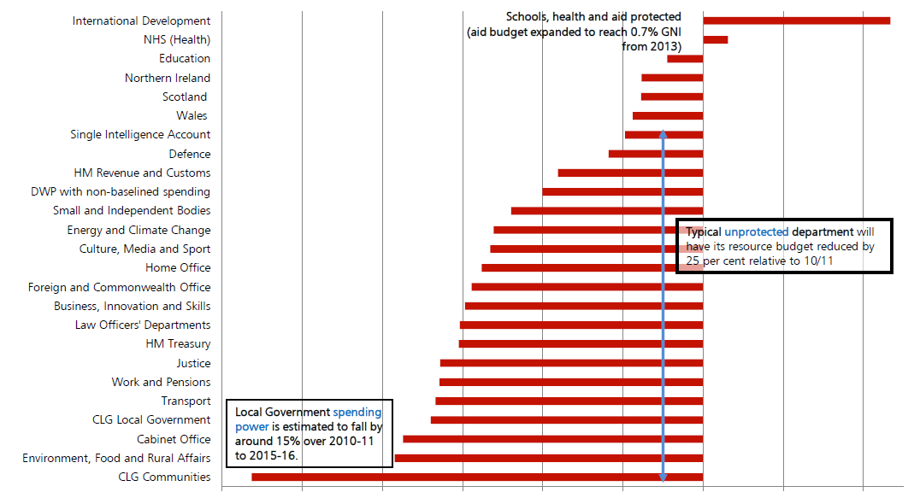
UK: Reductions in departmental spending SR10 and SR13
-50%
0
+20%
Percentage real-terms cumulative RDEL baseline reduction from 2010-11 to 2015-16

Slide 10
Lesson #4: Promoting ‘independence’ and ‘buy-in’
Dutch approach:
Independent, non-political working groups (high-level civil servants and external experts);
Reports have an objective, analytical, non-political status
Policy options can be inconsistent with political preferences and plans of Cabinet (but must be feasible!!)
Clear distinction between reports and political decisions:
Reports describe options and their impact
Cabinet is principal of spending review, sends report to Parliament, proposes policy changes in response to SR
Independent chair (Director-General not responsible for policy)
No veto: ideas may not be blocked by members working group
Reports are sent to parliament and are downloadable for public
Source: From presentation by Corina den Broeder, MOF, Netherlands

Slide 11
Netherlands: Outcome Comprehensive Spending Review 2009/2010
Substantial influence of Spending Review Reports on 2010 election programmes of Dutch political parties!
% uptake measures from Comprehensive spending review in election programmes
Political parties
Source: From presentation by Corina den Broeder, MOF, Netherlands

Slide 12
Key elements in UK Spending Reviews
The Finance Ministry (HMT) controls the timetable and parameter setting – major advantage
Owning and setting the key parameters at the start manages expectations and provides certainty for departments and markets
The negotiation around the margins. HMT sets headline budgets at spending reviews – line ministries have to plan the detail after the review
Parliamentary scrutiny follows allocations
Flexibility – required to revisit allocations several times as economy deteriorated
Planning ahead – start work early on the next review

Slide 13
Lesson #5: setting clear targets and costing options
Ministry of Finance usually sets the baseline:
New programs are normally dealt with separately
Guidance on ‘discretionary’ versus ‘non discretionary’, admin and capital spending
Guidance on costing—e.g. including treatment of arrears (i.e. health arrears = 1.1 percent of GDP)
Preventing ‘gaming’: options must be
Specific—measureable, costed, schedule for actions
Technically and politically feasible—e.g. treatment of collective wage agreements?
Beware of backloading results or simply cutting capital spending
Revisit rules (the ‘game’ adapts)

Slide 14
Methodology – Irish VFM Template
Test 1 – Rationale
Objectives
Test 2 – Effectiveness
Achieving objectives
Alternatives
Test 3 – Efficiency
Trend in outputs
Admin costs
Relevance
Benchmarking
Unit costs
Sunset Clauses
Impacts

Slide 15
Summary observations on success & challenges
Establishing Policy Priorities
Political input is needed to establish priorities, but within realistic constraints (but what about independence and elections?)
Setting the Spending Parameters
Central Finance Agencies set the overall spending parameters, but often with options for line ministries
Reviewing Departmental Programs
Relies on different levels of expenditure analysis
Line ministries have information and knowledge, no one size fits all
Improving value for money
Savings targets can be a useful anchor, if backed by deeper analysis
Delivering Better Outcomes
Need to set realistic performance trajectories—not too many, and then closely follow up on performance

Slide 16
Potential World Bank support
Methodology and organization of design
Work with MOF (Central Committee) and Joint Working Group (JWG) to design framework and TOR
Organize peer-to-peer workshop
Conduct of SR
Support analysis with data tools, analysis, benchmarking etc.
Support of the SR Committees to review output
Lesson Learning
Review process, Report, workshop review process (perhaps with peers)

Slide 17
Thank you
MACROECONOMICS AND FISCAL MANAGEMENT

