Slide 1
Spending Review: Public Sector Wage Bill
Emilia Skrok, Economist
World Bank

Slide 2
Plan of the presentation
Defining the problem
Objective of Spending Review
Options for Restraining and Reforming Pay
Experience of Poland
Options for Reducing Employment
Examples of guiding questions and principles to inform SR

Slide 3
Identifying the problem
Expenditure
Input
Output
Outcome
Efficiency
Effeectiveness
Croatia spends more on public administration than most other EU countries, but performs poorly in indicators of public administration effectiveness
Value for Money

Slide 4
Wage bill levels in Croatia are high
Public sector wage bill as percent of GDP, 2013
Central government wage bill as percent of GDP, 2013
Source: Eurostat, ESA 95
Notes:
There are a range of indicators that show the size and cost of the public sector and public service. Government expenditure as a share of GDP/GNI7, level of public expenditure per head of population and public service employment trends all give a sense of size
The cost of the public sector is shown by data on the Exchequer pay and pensions bill.

Slide 5
Though public administration employment does not look oversized
Public administration and defence; compulsory social security employment per 1,000 population
Source: Eurostat

Slide 6
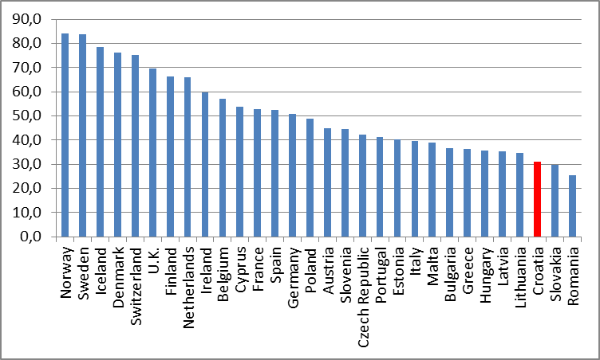
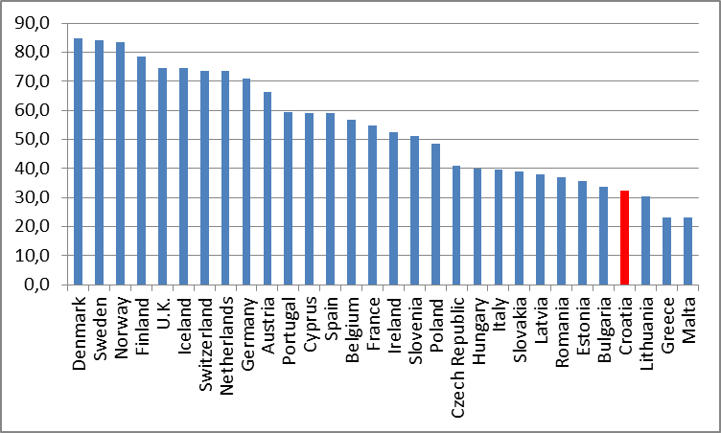
Public sector performance is poor
Public administration performance
Government performance score
Croatia’s Government Effectiveness: Composite Governance Indicator
Source: World Bank, 2014
Notes:
The quality and efficiency of public administration. Public administration includes policy making, policy legislation and management of the public sector. Such dimensions of public administration can often only be measured by subjective indicators of quality which give a sense of how good the public administration is. There is also an onus on public administration, all the more so in times of financial stringency, to show that services are being provided efficiently.

Slide 7
Spending review: CG wage bill
Objective: 10% saving on CG wage bill as compared to baseline (2014).
Main Questions:
What drives CG wage bill?
How many public sector jobs will have to go?
How CG earnings can be reduced?
Important: The key is to look for targeted measures that produce savings and reduce the wage bill, without adversely affecting service delivery.
Wages
Employment

Slide 8
Croatia wage bill compared to Poland …
Central government wage bill as percent of GDP
Poland
Croatia
Local government wage bill as percent of GDP

Slide 9
What can be done to restrain salary and reform pay setting?
Short term:
Wage reduction
Nominal wage reduction across-the-board
Rationalize some components of the pay (allowances, bonuses - where many of the de facto and potentially unwarranted salary increases could be found)
Review/rationalize salary of selected groups (salaries for staff where remuneration tends to be above private sector comparators
Long term:
Wage adequacy (to attract and retain staff, to motivate staff)
Changes to wage setting practices (grading exercise – position classification, jobs reclassifications, links to performance criteria)
Notes:
Allowances: It is here where many of the de facto and potentially unwarranted salary increases will be found

Slide 10
Examples of wage bill adjustments during the recent crisis
 | How? | When | Results
Estonia | Left it to individual institutions to decide how to make savings Measures included: Job cuts, reductions in additional pay, unpaid leave, cuts in basic pay | June 2008, with further reductions in December 2008, February 2009, June 2009, November 2009 & December 2009 | By 2010 paybill was 15% lower than in 2008
Greece | Centrally decided, by the government. Measures included: Allowances cuts (e.g. 14th month salary ) for public service employees (incl. in in publicly-owned companies) | January 2010; March 2010; May 2010; | cuts in allowances– 10%; 12% and 20% (plus 13th and 14th month salary reduced)
Latvia | Centrally decided by the government. Measures included: cuts in base pay; many bonuses and supplements abolished; widespread use of unpaid leave revised overall pay system from ( | January 2009; June 2009; January 2010 | 15% cut in pay but low paid protected; cuts in pay of 20% (for higher paid) and 15% for lower paid), protection for low paid abolished; cuts maximum basic pay by 5% ; by October 2010 paybill in state sector was down 35% as compared with 2008
Poland | Centrally decided by the government. Measures included: pay freeze ; | Since 2010 | Wage bill reduced by 10%, or 0.4pp of GDP

Slide 11
Poland: public sector wage bill is not high and wage bill envelope is well controlled
Size of employment in public administration and wage spending in Poland is not particularly high by European standards
MOF exercises tight control over the wage bill envelope of each ministry
A nominal wage freeze in budgetary sphere 2010-2014
The base salary comprises about 70% of total remuneration in the civil service (close to OECD average).
Main concerns in Poland relate to the system of pay setting:
adequacy of pay levels for some positions to attract and retain qualified staff and,
fairness of pay system (whether it ensures equal pay for equal work)
motivating role of the pay setting system (merit, performance related pay)

Slide 12
Pay seems to be competitive - at least during the economic slowdown
Comparison of Private Sector and Civil Service Wages, 2011
For higher level management and technical positions, wages in the public sector may be too low. And that for less skilled positions, they may be too high
Salaries for the highest-level professionals and managers (P5, M5are three times higher in the private sector than in the civil service.
BUT..
Turnover rates are low and applications per vacancy are high (one reason could be that private sector is not hiring)
Trends in Staff Turnover Rates, Percent

Slide 13
Excessive managerial discretion over wages and high discrepancies in pay levels
Poland lacks clearly defined job descriptions
Law sets out only five categories of staff and for each category, wide range of multipliers
Individual ministries may have narrower range of multipliers for specific positions
There is a high degree of discretion of unit managers to determine the multipliers of specific individuals
As a result…
Discrepancies in pay levels within and among agencies
Impact on staff morale and impede ability to attract good staff
2009 Civil Service categories and Multipliers

Slide 14
Options proposed for Poland
Greater clarity, more rules
clear position descriptions so that wages can be determined objectively and compared (new grade system)
narrower range of coefficients to reduce managerial discretion
more titles/grades to offer clear career path

Slide 15
How to cut public sector employment?
Short term measures:
Savings from vacant positions (canceling positions left vacant for more than 6-12 months)
Furloughs (forced leave-without-pay for a few days or weeks to reduce wage expenditure in the current year)
Recruitment freeze (full of partial freeze to fill vacancies)
Administrative function consolidation (consolidate the functions in central services units, downsizing in the process - human resource management, procurement, etc)
Notes:
(Institute for International Relations (2008), “Functional Reviews and Assistance in the Restructuring of State Administration Bodies and their Subordinate Agencies in Croatia”, World Bank-funded Public Administration Reform Project, November 2008.?)

Slide 16
How to cut public sector employment?
Long term measures:
Taking gains from automation and modernization (changing service delivery mechanisms i.e. heath care sector)
Contracting-out or out-sourcing (careful cost-benefit analysis is required)
Downsizing
Consolidation of ministries and departments
Rationalization of the number of state agencies and to streamline service delivery,
Functional Reviews of ministries
Reorganization elimination/merging of single-issue ministries and associated overhead costs
Reducing mid-level management .
Retirement policies (e.g. voluntary early retirement scheme, retire over-age staff (working pensioners))
Notes:
basic service delivery functions - many local or municipal functions - garbage collection but also at CG level - IT services, cleaning, catering
(important to take into account costs - it may take up to 2 years before the net savings exceed the immediate costs ; avoid adverse selection - where the public sector loses its best and brightest).

Slide 17
Reform of pay: examples of guiding questions for Croatia
Does a pay setting system succeed in controlling the aggregate wage bill?
Which salary components could be adjusted? 12 different bonuses/allowances?
How competitive it is? For which groups/organization units?
Are salaries high enough to attract and retain qualified staff?
Is pay equitable? (Is there ‘equal pay for equal work’?)
Does pay setting system motivate staff? Does pay provide an incentive for or even influence performance?
What are the legal and institutional arrangements for pay setting? Scope of collective negotiations?
Notes:
Extra bonuses: the years-in-service allowance,
there are 12 different bonuses that range from 4 to 150 percent of basic salary, are not mutually exclusive, and could be larger than the basic pay. None of them though is performance related
These include bonuses for overtime (50 percent), loyalty bonus (4, 8 and 10 percent, depending on the years of service), work at night (40 percent), work on Saturdays and Sundays (25-35 percent), working on shifts (10 percent), work on holidays (150 percent), special sector bonuses (working in health sector), duty roster bonus, on-call bonus, Christmas bonus, holiday bonus, transportation allowance, and child gift.

Slide 18
Reform of employment: examples of guiding principles for Croatia
Understand in detail both the size and the structure, main characteristics (age, skills, education) of the public sector workforce
Analyze what parts of the public sector workforce have grown or shrunk over time (education, health, judiciary). Why has it happened?
Understand in greater depth the extent to which particular public services are now being delivered by private sector
Identify critical tasks to be performed by administration and review individual positions in relationship to critical business needs
Notes:
Extra bonuses: the years-in-service allowance,
there are 12 different bonuses that range from 4 to 150 percent of basic salary, are not mutually exclusive, and could be larger than the basic pay. None of them though is performance related
These include bonuses for overtime (50 percent), loyalty bonus (4, 8 and 10 percent, depending on the years of service), work at night (40 percent), work on Saturdays and Sundays (25-35 percent), working on shifts (10 percent), work on holidays (150 percent), special sector bonuses (working in health sector), duty roster bonus, on-call bonus, Christmas bonus, holiday bonus, transportation allowance, and child gift.

Slide 19
Thank you

