Slide 1
Comprehensive Review of Expenditure
The Irish Experience

Slide 2
Background
Export-based growth 1994-2002,
Overtaken by Property Bubble 2002-2007
Banking crisis, collapse in output, and loss of property-related revenues
Underlying deficit (net of banking costs) over 10%.
Fiscal consolidation of 19% of GDP ultimately achieved 2008-14.
Evolving response to deepening crisis

Slide 3
Structure of the Consolidation
Breakdown of Fiscal Consolidation (€billion)
 | 2008 | 2009 | 2010 | 2011 | 2012 | 2013 | 2014
Revenue | 0.0 | 5.6 | 0.0 | 1.4 | 1.6 | 1.4 | 0.9
Expenditure | 1.0 | 3.9 | 4.3 | 3.9 | 2.2 | 1.9 | 1.6
Total | 1.0 | 9.4 | 4.3 | 5.3 | 3.8 | 3.5 | 2.5
Total (% of GDP) | 0.6% | 5.9% | 2.7% | 3.4% | 2.4% | 2.1% | 1.8%
Cumulative | 1.0 | 10.4 | 14.7 | 20.0 | 23.8 | 27.3 | 29.8
Cumulative (% of GDP) | 0.6% | 6.5% | 9.2% | 12.6% | 15.0% | 17.1% | 18.9%

Slide 4
Early Expenditure Consolidation Efforts
Stopping pay increases
Unilateral pay cuts
Commission on Taxation
2009 ‘Special Group’ McCarthy Report
Made up of outside experts – written by officials
271 Recommendations
Lots of ‘shock value’
Ideas helpful e.g. out-sourcing, procurement reform, etc
But implementation stalled quickly - Little buy-in from Departments
Only 41 recommendations implemented in full (111 in part)
Comprehensive Review of Expenditure Needed

Slide 5
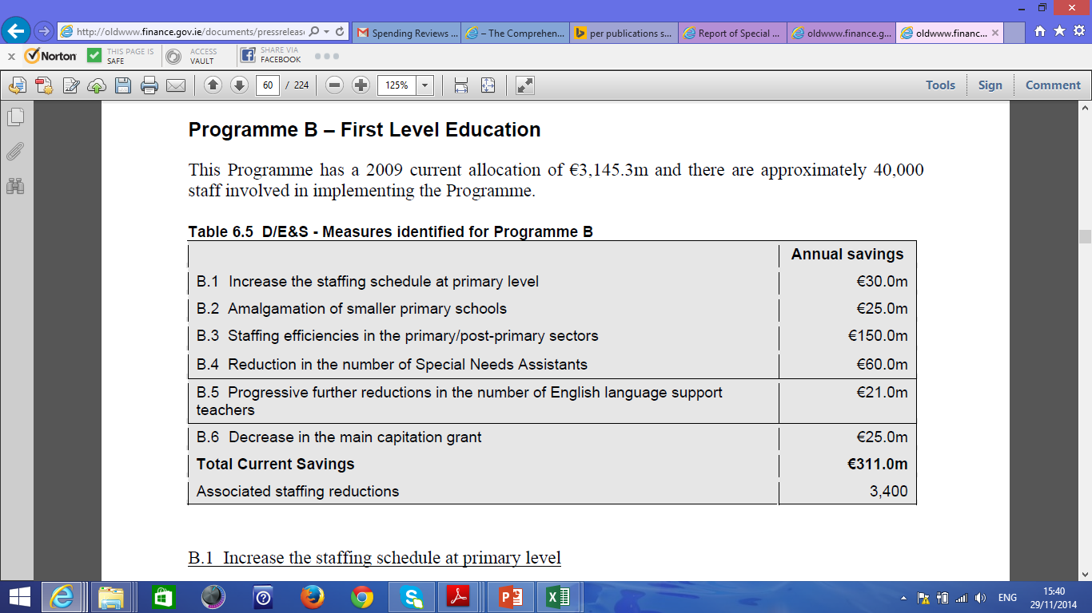
Example from McCarthy Report

Slide 6
New Government , New Structures after 2011
Department of Finance divided into DoF and Department of Public Expenditure and Reform
New Minister and Department with clear mandate to link spending decisions to reform and to reform public service
Economic Management Council (EMC) Established, consisting of two ‘finance’ ministers, Prime Minister and Deputy Prime Minister
Principles established in Programme for Government including Comprehensive Review of Expenditure.

Slide 7
New Structure
Government
Economic Management Council
D/Fin
D/PER
CRE Steering Group
Tax Strategy Group
Central Evaluation Unit
Line Departments

Slide 8
Core Objectives and Priorities
Objective To provide the Government with a complete set of decision options which can:
Re-align spending with the priorities set out in the Government Programme;
Meet the overall fiscal consolidation objectives, both in terms of total expenditure and staffing numbers reduction targets; and
Explore new and innovative ways of delivering Government policy in a reformed public service.
Priorities: Jobs, Reform and Fairness

Slide 9
The Administrative Process
Core input was expenditure reports from line departments
Each spending programmes subject to three tests
Departments provided with Report Template (attached) which were returned to D/PER
Central Expenditure Evaluation Unit compiled papers on ‘cross-cutting issues’
Inputs reviewed by Steering Committee (officials and advisors)

Slide 10
The Three ‘Value for Money’ Tests, and other issues
VfM Test 1 Rationale, Objectives, Relevance
What are the objectives of the programme? Is there a valid rationale for undertaking the programme? Is the policy consistent with the Government Programme?
VfM Test 2 Effectiveness
Is the programme achieving its objectives?
VfM Test 3 Efficiency
Is the maximum being delivered with the resources invested? How can greater efficiency be achieved in the context of a lower level of expenditure?
Other specific issues considered by Departments included rationalisation of grant and subsidy schemes; simplification of systems; rationalisation, merger or abolition of agencies; potential for shared services or external service delivery; and more widespread use of eGovernment.

Slide 11
The Political Process
Filtering and assessment by officials and Minister
Lists of proposed measures vetted by EMC
Bi-Lateral meetings with Line Ministers (merging with budget process)
Final discussion at EMC and at Government
Comprehensive Expenditure Report published on Budget Day
Large ‘unallocated savings’ remained. – political issue

Slide 13
Key Component was introduction of multi-annual expenditure ceilings
Legislation Required
Completely Changed the Dynamic in later years

Slide 14
Cutting the Wage Bill
Driven from the Centre ….
-24,700
-9%

Slide 15
Tax Expenditures
Opportunity to reform tax system, cutting out tax expenditures, and moving to wide-base-low-rate system
In this case, expert report was more useful, although problems agreeing on benchmark system
But, CASH IS KING
Legal issues more complex, and care was needed about property rights and investment incentives.
Some un-conventional measures were required

Slide 16
Some lessons
Core priorities matter to your capacity to carry people with you
Measures must be consistent with underlying ‘story’ about economic growth and jobs.
How is all of this going to lead to growth?
Multi-annual approach makes savings possible that would not happen with annual approach
Unit-cost reduction is vital
Implementation requires buy-in
No exemptions – every department contributes
Centre has to drive on wages and cross-cutting issues.
Process must build-in incentives to co-operate – PER ‘own’ measures
Difficult choices about staging of decisions and announcements – should we have announced everything in 2011?
It gets harder as you go along.

Slide 17
Lots of Reading
McCarthy Special Group Reports
http://www.finance.gov.ie/news-centre/press-releases/report-special-group-public-service-numbers-and-expenditure-programmes
Comprehensive Expenditure Report 2012-2014
http://www.per.gov.ie/comprehensive-review-of-expenditure/comprehensive-expenditure-report-2012-2014/
Department submissions and cross-cutting papers.
http://www.per.gov.ie/comprehensive-review-of-expenditure-submissions/
Legislation on pay reductions
http://www.per.gov.ie/public-service-pay-policy/
Commission on Taxation
http://www.commissionontaxation.ie/Report.asp
Issues in the evaluation of tax expenditures
http://www.budget.gov.ie/Budgets/2015/Documents/Tax_Expenditures_Oct14.pdf

