Slide 1

Restructuring Spending for Stability and Growth
CROATIA: PUBLIC FINANCE REVIEW
Sanja Madzarevic-Sujster
June 2014

Slide 2
Roadmap
Macro vulnerabilities and debt sustainability
    required fiscal adjustment of 4 pp of GDP over the medium term
Maximizing the efficiency of using EU funds
    requirements for the efficient use of EU funds → impact on growth and competitiveness
    required fiscal space of 1.8 pp of GDP per year
Fiscal adjustment policy mix
    a combination of revenue, tax administration and, especially, social sectors, subsidies and public administration reform
Can it be done?

Slide 3
Despite major development achievements…
Income per capita more than doubled between 1998 and 2008 (WB Atlas) → high-income country
At-risk-of-poverty rate fell; moderate inequality
Relatively low and stable fiscal deficit, sustainable debt levels
Inflation declined, stable exchange rate
Institutional strengthening - judiciary, regulatory framework, competition policies
28th member of the EU

Slide 4
…the global crisis exposed macroeconomic imbalances
Output loss over the last five years - 12% of 2008 GDP
Unemployment rate more than doubled (17% in 2013); youth unemployment at 50% and the lowest labor force participation in EU (44% in 2013)
5-Year CDS Spreads: Croatia in the Eurozone Perspective
Fiscal deficits increased to an average of 6% since 2009 and public debt doubled to 67% of GDP in 2013
External debt stayed elevated at 105% of GDP
Source: Bloomberg.

Slide 5
Structural problems hold back a recovery

Slide 6
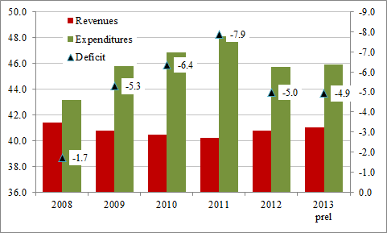
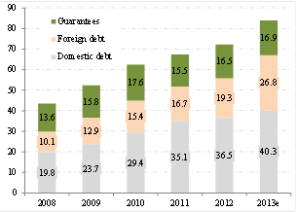
Growing fiscal vulnerability
    Croatia’s Fiscal Performance, % of GDP
    Evolution of Croatia’s Public Debt, % of GDP
Source: MoF, EUROSTAT, World Bank staff calculations. Fiscal data are shown per ESA95.
Delayed response to longer-term structural and (temporary) cyclical shocks
A large part of the fiscal deterioration is of a structural nature → structural deficit at 4% of GDP requires remedies with longer-term effect
The Government’s medium-term fiscal framework needs to follow the EDP → by 2016, primary expenditures to be reduced by 3.4 pp of GDP

Slide 7
Debt sustainability
Public debt and interest payments higher and rose much faster than that of EU10 from the lower level in 2009
Interest payments only marginally lower than capital expenditures
17% of GDP in contingent liabilities (raising debt to 84% of GDP)
That level of debt consistent with particularly weak growth performance, especially after the global crisis

Slide 8
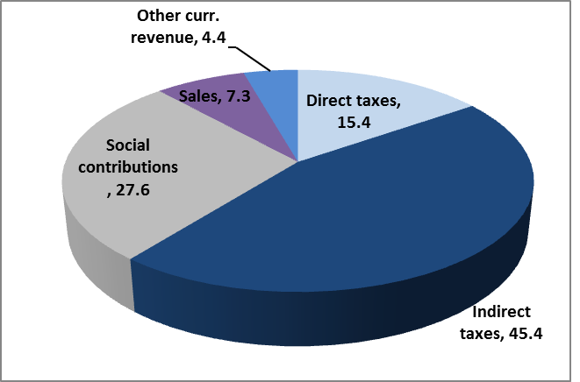
Revenue composition
  General government revenues, % of total revenues
  General government revenues, % of GDP
Source: MoF, Eurostat, CROSTAT, staff calculation.
Total revenues are about 3 percentage points higher than in EU10
Indirect taxation already overly high
Nevertheless, there is still some scope for raising overall revenues.

Slide 9
Spending composition
    General government expenditures by economic and functional classification, % of GDP
Source: MoF, Eurostat, CROSTAT, staff calculation.
Croatia’s spending level is 4.3 pp of GDP higher than in its EU10 peers
Spending is particularly excessive for subsidies, public wages and consumption
Social spending (health, education, and social protection) 3 pp of GDP higher than in EU10; education spending is on par with EU10 and EU15, while health is an outlier.
General public services and economic affairs comparatively higher

Slide 10
Spending effectiveness
Apart from addressing the level, effectiveness is an issue→ contradicts the amount of public resources allocated
    Performance of Government Services

Slide 11
I. EU funds: an opportunity…
Croatia: First-Round Demand Effect of EU Funds, % of GDP
Overall effect on economic growth positive, but could be lagged
In the short term: modestly higher domestic demand (less than ½ percent GDP); in the long run: they should contribute to economic growth from the supply side.
During 2009-11, ESI represented over 70% of public investment in HU, SK, BG, LT, EE and over 50% in PL and CZ
Demand impact was projected at around 3% of GDP per year in BG.
Note: when α=1 if there is no substitution.
Source: World Bank Staff, based on Rosenberg and Sierhej (2007)

Slide 12
EU funds:…and the fiscal challenge
Net Impact of EU-related Funds on the Fiscal Deficit, ESA95, % of GDP
Croatia: Net fiscal effect, cash basis, % of GDP
Notes: The strict additionality principle assumed.
Source: World Bank staff estimates, based on data from MFF 2014-2020
Note: Substitution as reported by the authorities for HU; maximum substitution according to EU rules for other
Source: Rosenberg, Sierhej (2007)
Fiscal space needs to be created to support their absorption, averaging up to 1.8% of GDP a year.
Given Croatia’s large fiscal deficit, it is important to manage EU-related funds through expenditure switching and substitution policies.

Slide 13
Policies for maximizing the efficient use of EU funds
Link regional and national priorities with the Cohesion Policy priorities.
Develop a clear strategic vision for national priorities and EU funds’ allocation at all levels.
Switch away from lower priority spending, and substitute for domestic spending where possible.
Build capacities related to the EU funds’ identification, preparation and implementation, especially at the local level.
Set up a sound financial management system at all levels (local, regional, national) and in all EU funds beneficiaries.
Establish comprehensive budget management systems to avoid different approaches to financing sources.

Slide 14
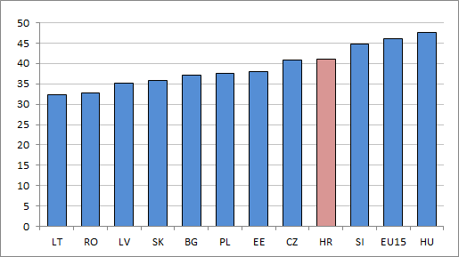
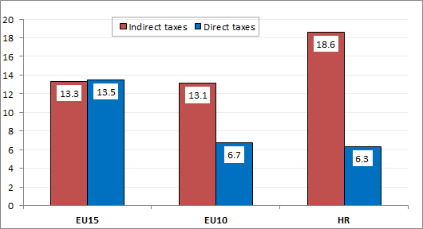
II. Revenue-side adjustment
Croatia has the second highest revenue burden among the EU10 (41% of GDP) → high indirect taxation and low direct taxes.
Tax space (the amount of revenue given the country’s economic strength rather than what the legislature has mandated) is negative.
General government revenue, 2013, % of GDP
Indirect and Direct Taxes in 2013, % of GDP
Source: Eurostat

Slide 15
Revenue-side adjustment…recommendations
Introduce value-based modern property taxation.
    Could add up to 1.5% of GDP in new tax revenues over time
Support fiscal devaluation through labor taxes while in parallel eliminate a large number of tax exemptions given to households and businesses
    Could bring an additional 1% of GDP to new revenues
    Design of personal income taxation and exemptions should reduce disincentives to work
Strengthen and modernize Croatia’s tax administration (CTA) to protect and expand the revenue base:
    a compliance risk management system;
    strong administration at HQ and the LTO strengthened;
    a streamlined network of regional and local tax offices; and
    a sound IT governance.

Slide 16
III. Rightsizing the government
Cost of government services is high (even relative to the general price level and once controlled for per capita real income).
Large size (17% of the labor force) → growing number of public service employees
Relatively low effectiveness and still highly politicized → pay is largely based on seniority; not performance
    General government wage bill, % of GDP
    Public administration performance score
Source: Eurostat, MoF, Weighted average for EU15 and Eu10.
Source: Eurostat 2013.

Slide 17
Rightsizing the government
Local government
Unclear spending assignments → large cities provide most of decentralized public services, questioning the existence of other LGUs. Only fire protection is almost completely decentralized.
Excessive fragmentation → 1/2 goes for wages and operational costs, while less than 1/5 for investment
Limited fiscal independence → 2/3 of revenues transfers from the national government (equalization system plays as disincentive to collect taxes)
Persistently high vertical fiscal imbalances
  Average Inhabitant per Local Government, EU, 2011
  Fiscal Imbalances, 2002–2012
Source: Eurostat, MoF, Weighted average for EU15 and Eu10.
Source: Eurostat 2013.

Slide 18
Rightsizing the government…recommendations
Some 2% of GDP in cumulative savings could be achieved over the medium term
Rationalization of the wage bill (targeted downsizing; the wage system reform; a full application of the HRMIS)
Finalize provisions regulating criteria for the creation and management of agencies
Professionalization and the introduction of performance based management practices
Proceed with territorial reorganization or incentives to encourage joint provision of services
Redefine spending responsibilities of local governments to avoid duplication and overlap of functions and to increase accountability of LGUs for service delivery
Increase LGUs’ reliance on own-source revenues to reduce central government transfers
Monitor fiscal operations of subnational governments to ensure fiscal prudence and alignment with the EDP

Slide 19
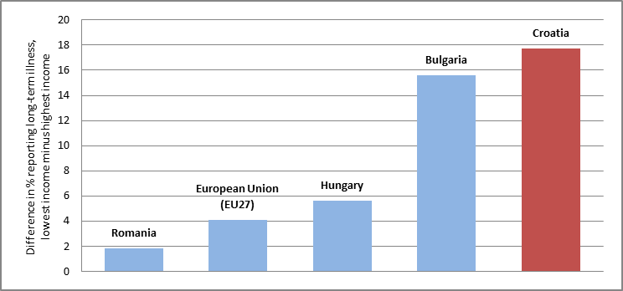
IV. Health
Good health outcomes but at high cost (9% of GDP compared to 5.4% of GDP on average in the EU10)
Rapid aging of the population → non-communicable, chronic diseases and morbidity will continue increasing, with need for additional health and LTC.
Chronic arrears (1% of GDP at the end-2013 or 15% of their revenues)
Socio-economic and geographic disparities in health indicators in Croatia
Inequality in Reported Long-term Illness in Croatia and Selected EU Countries, 2010
Health Expenditure and GNI per capita, 2010
Source: Eurostat, EU SILC
Source: WHO, Global Health Expenditure Database. Croatia is red-shaded diamond.

Slide 20
Health…recommendations
Some 1% of GDP in savings could be achieved without adversely affecting the level and equity of service
Consolidate health service networks by geographic areas to streamline services for acute cases (like in the National Plan)
Create high-frequency lower-cost specialized centers for ambulatory diagnosis and treatment (could reduce unit costs by about 30 to 70%)
Reduce further the referral rates in the primary health care and expand public health services to reduce the prevalence of behavioral risk factors
Strengthen public FM systems to prevent arrears reoccuring
Rationalize exempt copayment categories (40% of population) and adjust the complementary health insurance premium with actuarial standards
Expand eHealth systems

Slide 21
V. Pension system
Worsening demographic ratios: 17.3% of population over 65 and an old-age population dependency ratio of 23.8%
System dependency rate of 1.17 and declining: low active coverage rate (only half of aged 15+ contribute), low formal labor participation, rising unemployment, early exit from the labor force
Minimum pensions are highly redistributive: the net replacement rate for minimum wage earners with 40 years of service is over 100%; 3% lower than for the average wage earners.
Inadequate pensions for multipillar cohorts
Overly generous privileged pension schemes: HWV disability and survivors benefit 2.4 times higher than the old-age pension. The minimum pension granted to HWVs with less than 6 years of service was 10 percent above the average pension earned with more than 33 years of service.
Source: MoF, staff calculations.

Slide 22
Pension system…recommendations
Gradually raising the second pillar contribution rate.
Accelerate the retirement age increase before 2030 and tighten and phase out the early retirement.
Rationalize the categories of privileged pensions and accelerate convergence of privileged pensions to PAYG by equalizing the maximum privileged pension with the old-age maximum pension.
Use means-testing for granting minimum pensions and award pension points only for periods with contributions paid.
Revisit the pension indexation.
Tighten the disability assessment procedures.

Slide 23
VI. Long-term care
Basic infrastructure exists, but a comprehensive LTC plan is needed
    severely dependent population (at around 300,000) is growing by more than 1% annually
  Increase in institutional capacity for LTC provision by non-state institutions (up by 36%) with the rise in LTC employees increased by 29% in 2003-12 period
  Inverse dependency ratio: by 2050 there will be six potential care providers for each severely dependent person and there will be two potential taxpayers for each person of retirement age.
  Public spending on LTC will grow from the current 0.15% of GDP to about 1.3% of GDP in the medium variant

Slide 24
Long-term care…recommendations
Develop a comprehensive LTC plan.
Shift LTC services from the health to the social sector because they will be mostly social services, and cost less than health services.
Favor community-based over institutional care.
Decrease care fragmentation and increase coordination (health and social welfare, local and national govt and civil society).
Explore a shift from the government-producing LTC services to buying them from the private sector.
Target government funding through means-testing (half of beneficiaries were able to fully finance their social service costs in 2012, with a gradual decline of national state subsidies to 42%)
Explore the potential of cash benefits and vouchers for funding LTC.

Slide 25
VII. Social assistance
Relies on poorly targeted, categorical rather than needs-based benefits → persistence of poverty and social exclusion
Costly system (3.8% of GDP, using broader; 2.4% of GDP using narrower definition); well-targeted GMB accounts for less than 0.4% of GDP
Low coverage and generosity of social assistance programs – around 1/2 of the poorest quintile and about 27 percent of overall resources
Disincentive employment effect found for family-based social assistance (27% of the NEETD population)
Targeting Accuracy of Social Protection Programs, 2011
Source: HBS.

Slide 26
Social assistance…recommendations
Savings of about 0.85% of GDP could be achieved while improving targeting
Introduce a single, unified set of criteria to assess eligibility for needs-based social assistance programs (through one-stop-shop).
Extend means-testing to most social assistance and family programs.
Introduce a parametric redesign of the child tax allowance.
Implement “make-work-pay” benefit reforms.
Strengthen oversight and inspection.
Consolidate the administrative system at national and local levels.
Eliminating Elite Capture in Non-Contributory Social Assistance Programs
Source: Estimates based on HBS 2011

Slide 27
VIII. Rationalizing subsidies
At 2.1% of GDP spending double compared to the EU; dominated by selective, sectoral and firm-specific state aid
Railway, road and port infrastructure account for 90% of all guarantees
Low and sometimes deteriorating performance indicators suggest the ineffectiveness of state aid, especially for railroads, ports, and agriculture.
Transition from sector-specific to horizontal types of state aid (like R&D)
Potential savings of about 1% of GDP
Croatia’s Total Non-Crisis State Aid and Its Structure, % of GDP
Source: EUROSTAT, Croatian Competition Agency (CCA).

Slide 28
VIIIa. Railways
Part of the European transport network → EUR 2bn in the period 2014-20 for investments
Public transfers to railways amounted to 0.6% of GDP in 2012 (half for infrastructure)
5.8% of GDP invested in railway since 2002 (15% of GDP invested in motorways)
Significant decline in demand (by 36% since 2007, measured in million traffic units), poor operating performance, and an aging rolling stock (the majority of assets are more than 30 years old)
    Low efficiency:
    Labor productivity low and falling since 2008, mainly due to overstaffing
    Wage bill remains unsustainably high (70% of operating revenues for labor costs, compared to 40% in EU)
    Weak financial performance
Key Performance Indicators of Railways
Source: HZ, State budget, World Bank calculations.

Slide 29
Railways…recommendations
Subsidies could be decreased by 0.3 percent of GDP without significantly affecting the service
Define an affordable level of funding for the sector, along with an overall transport investment program.
Set the structure of the financial support to railways through PSC and MAIC.
Adjust the level of services and the network size.
Strengthen the contractual relationships of the infrastructure manager and passenger operator.
Enforce the restructuring program to meet planned cost cutting targets (a 50% staff cut from 2011 levels would bring staff productivity to EU27 levels)
Maximize EU Funds absorption for investments and secure national contribution (close to EUR600 million) from operational savings

Slide 30
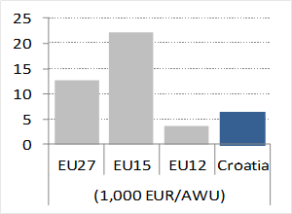
VIIIb. Agriculture and Rural Development
Increase in the ARD budget over the last decade (to above 1% of GDP—double w/r most EU), but low small farm productivity
Good overall land productivity (due to 2/3 of agricultural area larger than 10 hectares), but a high share of subsistence-agricultural holdings weakens overall labor productivity
The standard output of an average Croatian farm is still about 5 times smaller than that of the average EU15
Market interventions not fully compatible with the EU
The quality and efficiency of agricultural policies significantly lower compared to other EU countries – and the gap is growing
Farm Labor Productivity, Croatia and the EU (2005-11 average)
Source: Eurostat.
Agricultural Policy Costs
Source: Global Competitiveness Index, World Economic Forum.

Slide 31
Agriculture and rural development…recommendations
Reduce spending by 0.2-0.5 percentage points of GDP to align its spending level to most other EU countries
Make strategic decisions on the allocation of the sector budget between the nationally-funded expenditure categories and avoid duplicating EU-funded interventions
Enforce subsidy modulation and eliminate income support (instead consider means-testing minimum pensions)
Strengthen and rationalize public services in agriculture (25% of total sector spending)
Ensure fiscal discipline, budget transparency, and streamlined budget planning priorities
Terminate “market interventions” on milk, mandarins and apples
Take advantage of the option to transfer Pillar 2 funds into the CNDP envelope for 2014-16 (would save 0.13% of GDP)

Slide 32
Ensuring sustainability
Croatia has entered EU but its fiscal weaknesses and vulnerabilities pose substantial risks for future
→ substantially reduce those risks, putting its public debt on a downward trajectory
To achieve debt sustainability, the government will need to turn 1.8% primary deficit in 2013 into a balance by 2015
→ around 1.5 pp of GDP in structural deficit reduction required
Simultaneously, Croatia will need to create fiscal space of 1.8% of GDP a year in 2014-20 to support EU funds absorption
→ through the efficient utilization of EU funds, combined with substitution (where allowed) and switching of budget spending toward high return investments
Croatia’s spending and revenue pattern offers a sizeable scope for fiscal adjustment of 4-5 pps of GDP
→ raise additional revenue of 2% of GDP with limited adverse impacts on growth and employment, but focus should be on the spending side

Slide 33
Can it be done?
Average annual cyclically adjusted primary balance improvement, % of GDP
Source: EUROSTAT, World Bank staff calculations

Slide 34
Thank you!

